Slide 1
Thinking Positively about the Future
Chapter 8

Slide 2

Imagine Your Future

Slide 3


Slide 4

Let’s Visualize Your Future

Slide 5

As a college student:
Visualize yourself in your cap and gown walking across the stage to receive your diploma.

Slide 6
Exercise:
Visualize Your Success
Draw a picture, make a list or write some sentences.
Share with the class

Slide 7

Powerful Tools for Success
Optimism
Hope
Future-Mindedness

Slide 8

Believe in Yourself
If we have positive beliefs about ourselves, we will feel confident and accomplish our life goals.

Slide 9
Beliefs:
Personal opinions about yourself, your life and the world around you

Slide 10
For Example
If I believe I am not good in math, I may not do the assignment or may even avoid taking math.
If I believe I can be good in math, I can take the steps needed to be successful.

Slide 11
The Self-Fulfilling Prophecy
Our expectations influence our behaviors.
The behavior causes our expectations to come true.

Slide 12
Robert Rosenthal
Did experiments on the “self-fulfilling prophecy.”
Positive expectations led to positive outcomes.

Slide 13

Positive Self-Talk
The thoughts or silent inner voice in our heads

Slide 14

Negative Thoughts
Can be toxic to the body
Can cause biochemical changes that lead to depression

Slide 15

Positive Thoughts
Build good self-esteem
Help us to become confident in our abilities
Help us to achieve our life goals

Slide 16
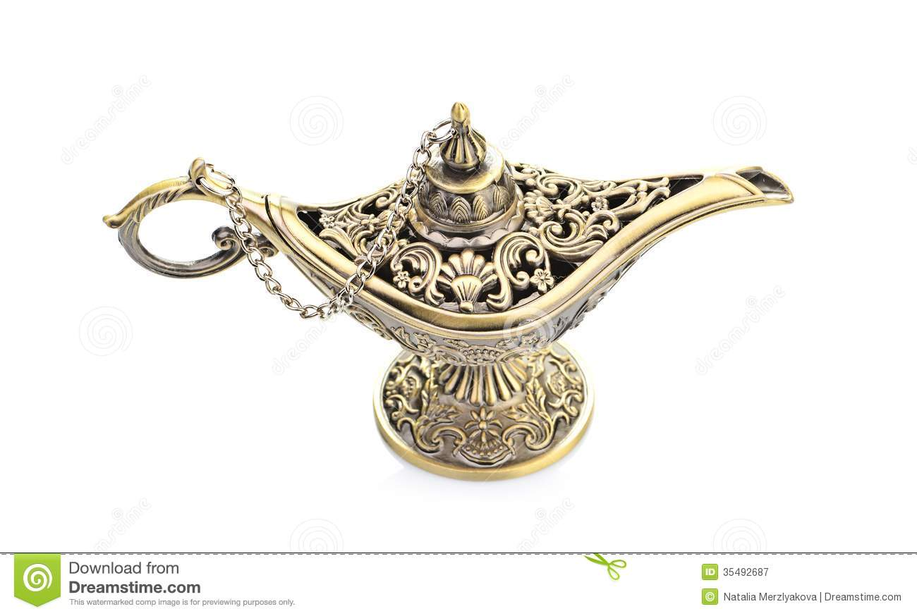
On a sunny beautiful San Diego day you are walking on the beach and suddenly to stub you toe on something in the sand.
Affirmations
You look down and see something is stuck in the sand. You bend over and pick it up. You brush off the sand off, It’s a lamp!

Slide 17
The lamp tells you it will grant you 3 wishes with the following
conditions.
1. You cannot wish for money
2. You cannot wish for more wishes
3. It must be for you
4. It must me realistic
What three wishes would you wish for?

Slide 18
Change the wishes to affirmations
Example:
The wish: I wish for good health.
The affirmation: I enjoy having good health.
Share your affirmations statements with the class

Slide 19

About Your Life and Your Future

Slide 20
Guidelines for Increasing Positive Thoughts
Monitor your thoughts. Are they positive or negative?
When you notice a negative thought, imagine rewinding the message and recording a new positive message.

Slide 21
Guidelines for Increasing Positive Thoughts
Start the positive message with “I” and use the present tense.
Make your affirmation stronger by visualizing what you want to achieve.
Repeat positive thoughts to yourself until they become a habit.

Slide 22
Athletes Use Visualization
A good way to practice
Helps you to pre-experience events in your mind
For example, pole-vaulters imagine the perfect jump before they make it

Slide 23
Visualization
We create all things twice.
  Make a mental picture.
  Create the physical reality by taking action.

Slide 24
For example:
In building a house we
  Create a blueprint or plan
  Then we build the house

Slide 25
Hope for the Best
Believing that you can be successful helps you to be successful.
Hopeful students are more successful.

Slide 26

Seven Habits of Highly Successful People

Slide 27
Be Proactive
Accept responsibility for your life.

Slide 28
Begin with the end in mind.
Know what is important.
What do you want to accomplish in your life?

Slide 29
Put first things first.
Set priorities.

Slide 30
Think win-win.
Seek solutions that benefit everyone.
Focus on cooperation rather than competition.

Slide 31
First seek to understand. Then be understood.
Listening is the first step in effective communication.

Slide 32
Synergize.
The whole is greater than the sum of its parts.
Working together as a team, you can accomplish more than each member can accomplish separately.

Slide 33
Sharpen the saw.
Invest time in yourself to stay healthy:
  Physically
  Mentally
  Spiritually
  Socially

Slide 34
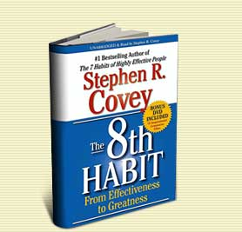
Find your voice and inspire others to find theirs.
Believe that you can make a difference in the world and inspire others to do the same.

Slide 35
Understanding Life Stages
Understand the present.
Take a glimpse into the future.

Slide 36
Finding happiness in your life.

Slide 37
Steps to Happiness
Express gratitude.
Cultivate optimism.
Avoid over thinking and social comparison.
Practice acts of kindness.
Increase flow activities.

Slide 38
Steps to Happiness
Savor life’s joys.
Commit to accomplishing your goals.
Take care of your body.

Slide 39
Secrets to Happiness
Martin Seligman
Achieve happiness by identifying, cultivating, and using your personal strengths in work, love, play, and parenting.

Slide 40
Happiness = S + C + V
S is your set range (50% of happiness is determined by heredity)
C is your circumstance (8-15 % of happiness)
V is what is under your voluntary control (40%)

Slide 41
What are some examples of factors under your voluntary control?

Slide 42
More Secrets to Happiness

Slide 43
Secrets to Happiness
Happiness can’t be bought.
Happiness is more internal than external.
Happiness is not determined by age, race, gender or income.
Happiness won’t arrive in the Publisher’s Clearinghouse envelope.

Slide 44
Secrets to Happiness
Happiness depends less on things than on our attitude toward the things we have.

Slide 45
Make a decision to choose happiness.

Slide 46


Find small things that make you happy and sprinkle your life with them.

Slide 47
Laugh more. Laughter produces a relaxation response.

Slide 48

A good joke beats a pill for a lot of ailments.

Slide 49
Learn to think like an optimist. Assume you will succeed.

Slide 50


Replace negative thoughts with positive ones.

Slide 51
Do things that use your skills.

Slide 52
Fill your life with things you like to do. Remember the 20 things you like to do?

Slide 53
Get enough rest.

Slide 54
Exercise to feel good and to cope with anxiety.

Slide 55

There are no substitutes for fresh air, sunshine and exercise.

Slide 56
Reduce stress.

Slide 57
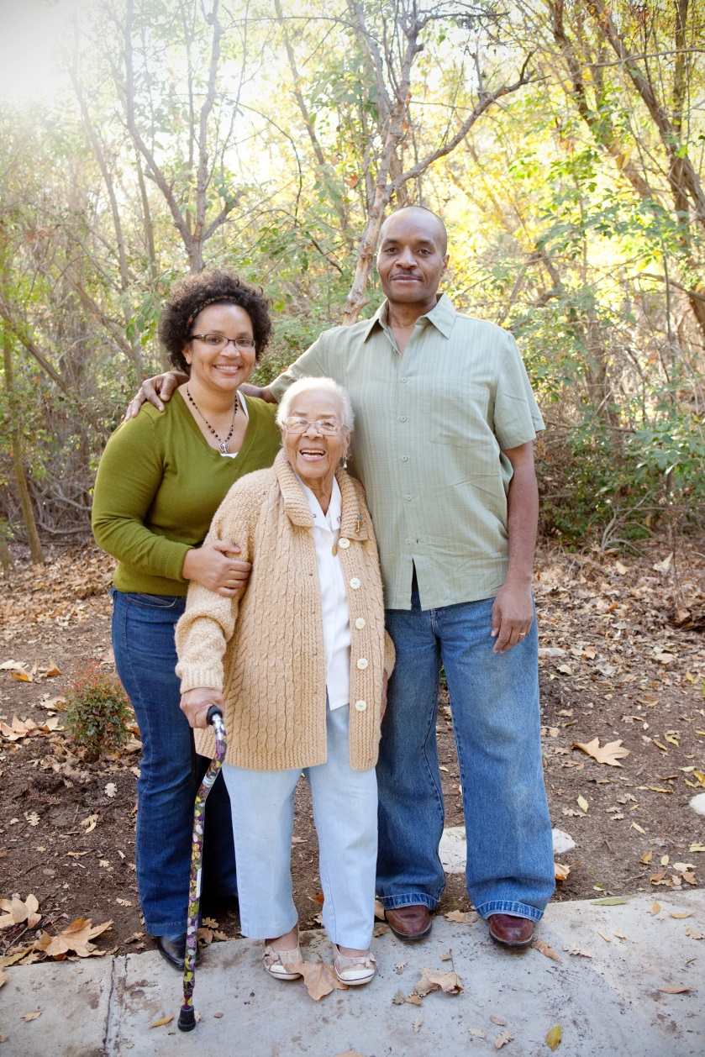

Close relationships are important.

Slide 58
If you don’t do anything else in life, love someone and let someone love you.

Slide 59

Keep things in perspective. Will it matter 10 years from now?

Slide 60
Exercise:
Happiness Is . . . .
Share Your Ideas

Slide 61
Keys to Success:
You Are What You Think

Slide 62
What we believe is true, comes true.
What we believe is possible, becomes possible.
--Henry Ford

Slide 63
Watch your thoughts; they become words.
Watch your words; they become actions.
Watch your actions; they become habits.
Watch your habits; they become character.
Watch your character; it becomes your destiny.
Frank Outlaw

Slide 64

Grand Essentials of Life

Slide 65

Grand Essentials of Life
Something to do (that you like)

Slide 66
Grand Essentials of Life
Something to do (that you like)
Someone to love

Slide 67

Grand Essentials of Life
Something to do (that you like)
Someone to love
Something to hope for

Slide 68

Use the tools in this book to create your success.

Slide 69
This is not the end of the course but a new beginning.

Slide 70
CONGRATULATIONS
Future
Graduates

Slide 71
Review the Keys to Success in this book. What is your favorite one and why?

Slide 72

Measure Your Success
Complete the exercise.
Pick up the one you did the first day of class.
Compare your results. Is your score higher?
Staple the two exercises together and hand them in.

